Slide 1
Native American Cultures Review

Slide 2
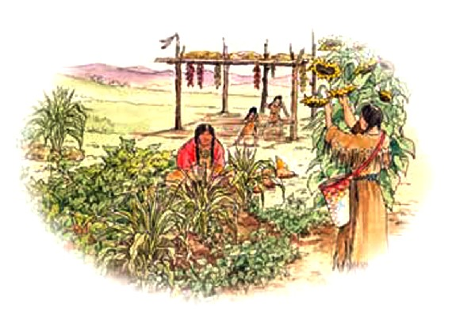
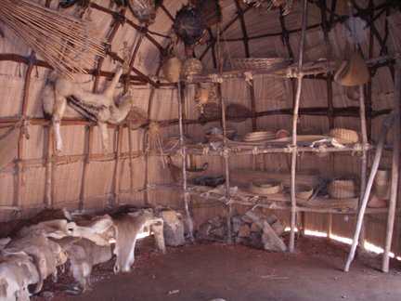
Powhatan
Food
Farmed: corn, squash, and beans
Hunted: deer, turkeys, fish
Shelter
Wigwams and Longhouses
Council houses and food storage
Powhatan Farming Techniques
Powhatan-style Storage House

Slide 3
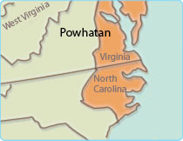
Powhatan Territories

Slide 4
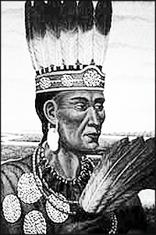
Powhatan
Roles of Men/Women in Society
Men: waged war and hunted
Women: farmed, gathered foods, built buildings
Role in US History
Helped settlers at Jamestown initially survive through Chief Powhatan, his daughter Pocahontas and John Smith
Eventually waged war with settlers in Virginia
Chief Powhatan

Slide 5
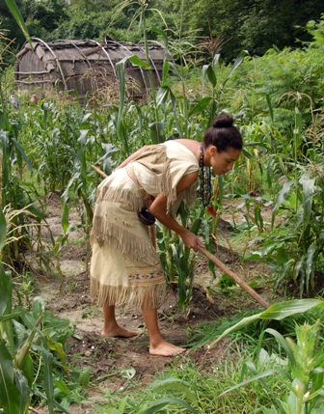
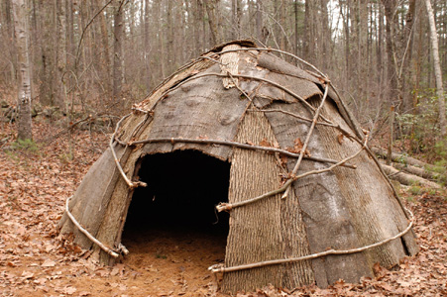
Wampanoag
Food
Farmed: corn, squash, and beans
Gathered: berries, nuts and herbs
Hunted: deer, turkeys, fish
Shelter
Wetus – small round houses
Wampanoag Farming Techniques
Wetu

Slide 6
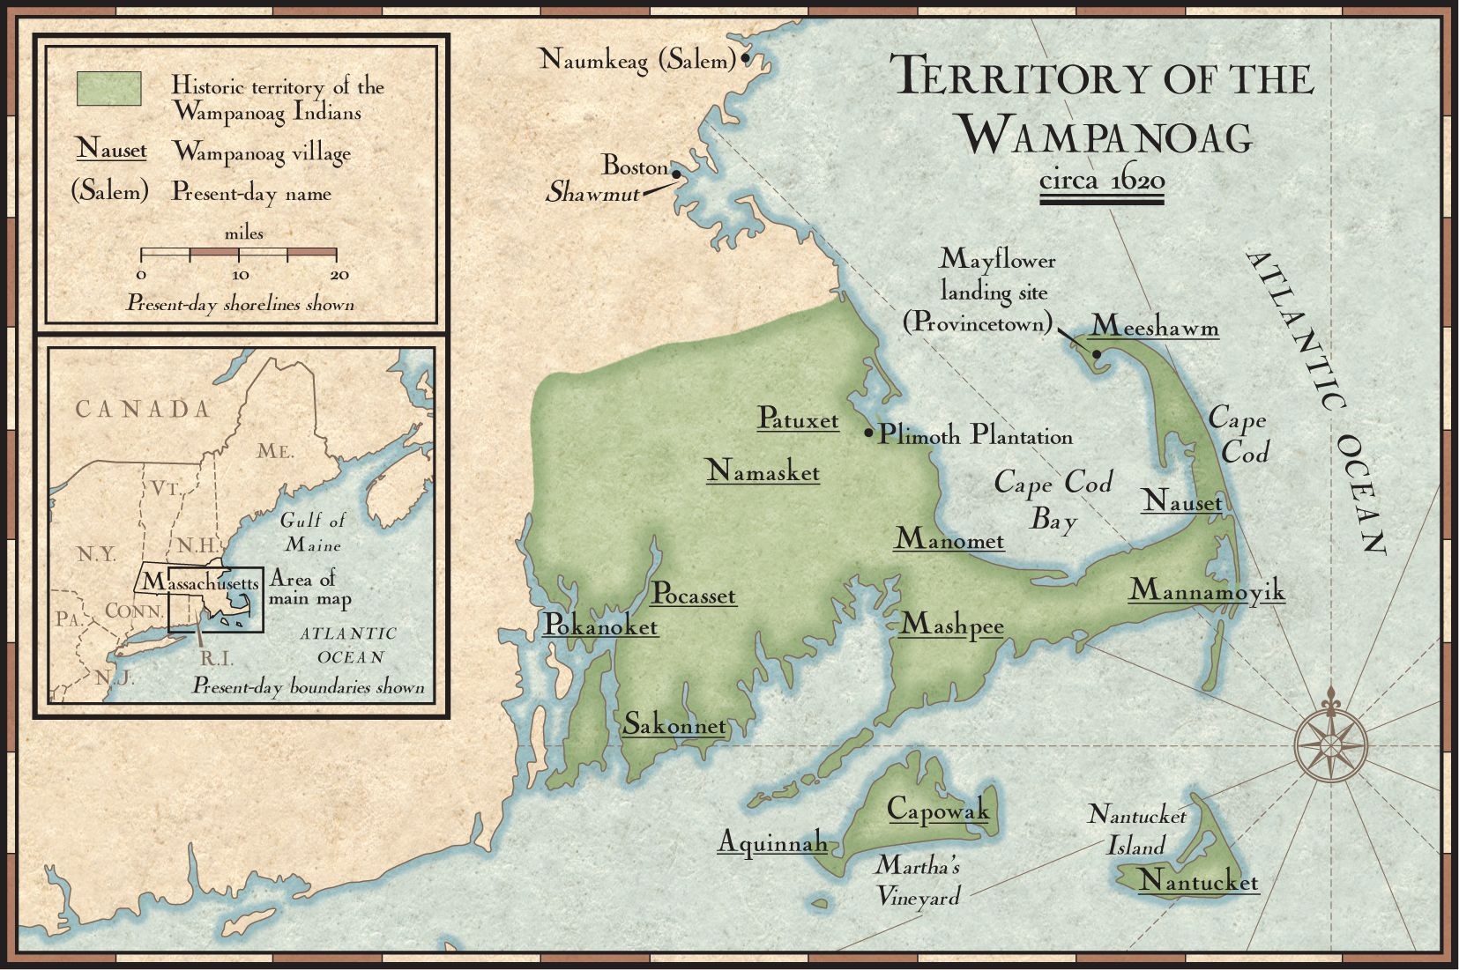
Wampanoag Territories

Slide 7
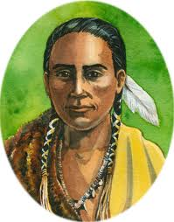
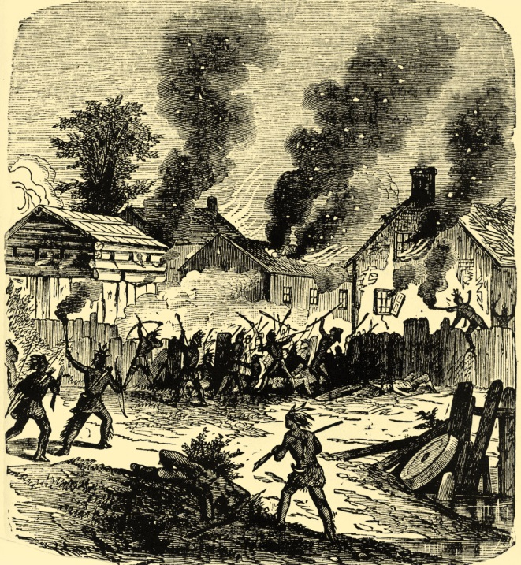
Wampanoag
Roles of Men/Women in Society
Men- hunted, went to war
Women – cared for children, cooked, farmed
Role in US History
Helped Pilgrims survive by teaching farming techniques (Squanto)
King Philip(Metacom)
Tensions increase
Squanto
King Philip’s War

Slide 8
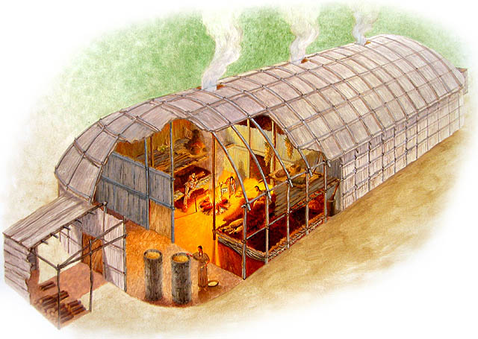
Iroquois
Food
Farmed: corn, beans, and squash
Gathered: wild berries and herbs
Hunted: deer, elk, fish
Shelter
Longhouses
Wood-framed buildings covered in elm bark
Iroquois Longhouse

Slide 9
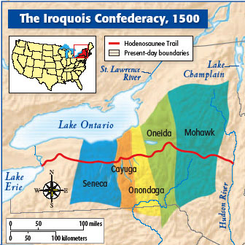
Iroquois Territories

Slide 10
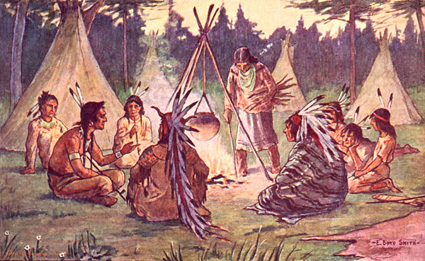
Iroquois
Role of Men/Women in Society
Men – Hunting, trading, war
Women – Farming, property, family
Role in US History
The Iroquois Confederacy(founded by Hiawatha in 1504) Joined forces with the British in the French and Indian War
Flag of the Iroquois Confederacy

Slide 11
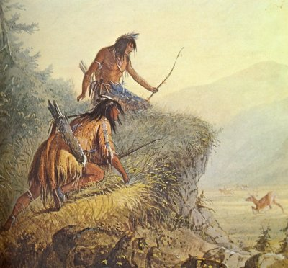
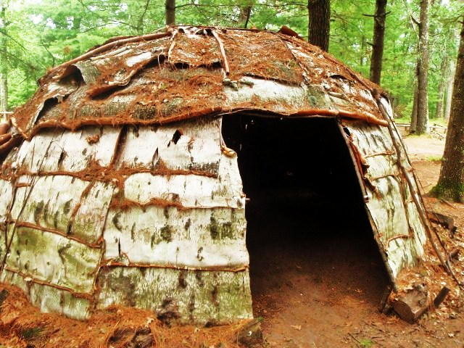
Ottawa
Food
Farmed: corn, beans, and squash
Hunted: deer, small game, fish
Shelter
Waginogan (wig wams): houses made of birchbark
Birchbark wigwam

Slide 12
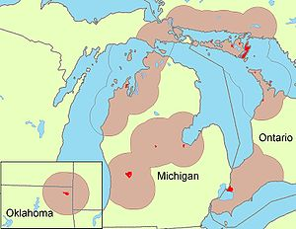
Ottawa Territories

Slide 13
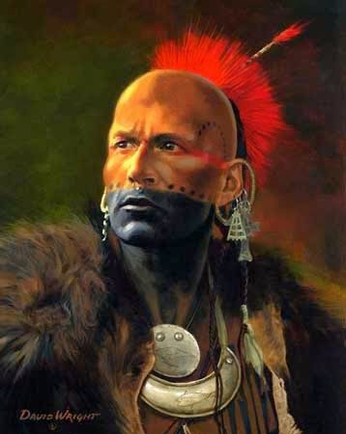
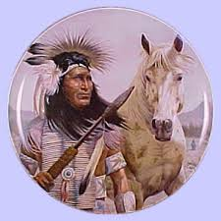
Ottawa
Roles of Men/Women in Society
Men: hunted, went to war, acted as chiefs
Women: farmed, raised children, cooked meals
Role in US History
Maintained a massive trading network in which furs were traded with the French and British
Sided with the French in the French and Indian War. Pontiac led a rebellion against the British that helped cause the Revolution.
Pontiac

Slide 14
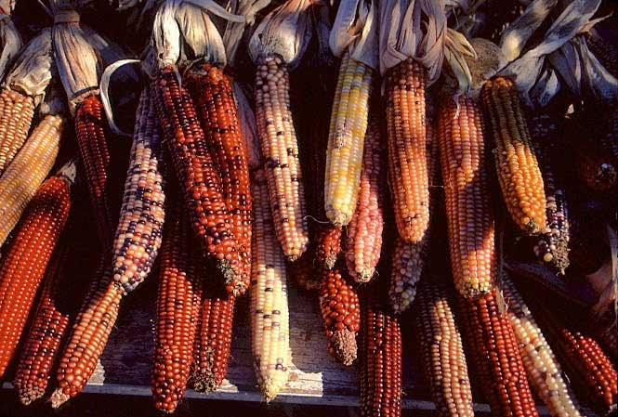
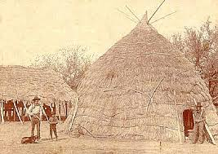
Cherokee
Food
Farmed: corn, beans, squash, and sunflowers
Gathered: berries, nuts, and fruits
Hunted: deer, wild turkeys, fish
Shelter
Houses made from rivercane and plaster with thatched roofs

Slide 15
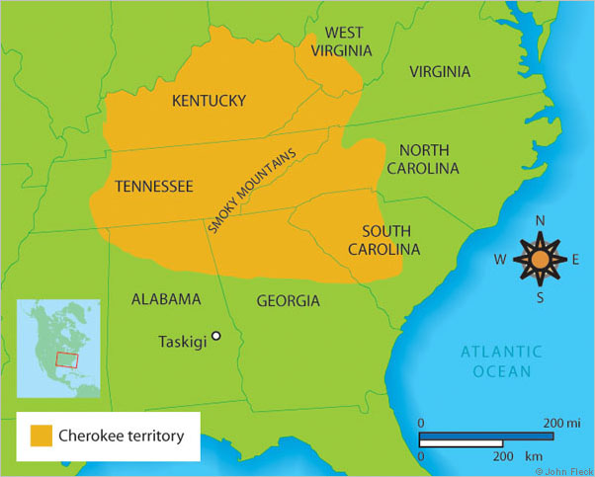
Cherokee Settlements

Slide 16
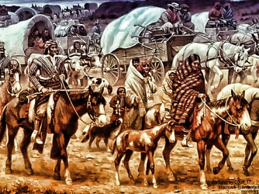
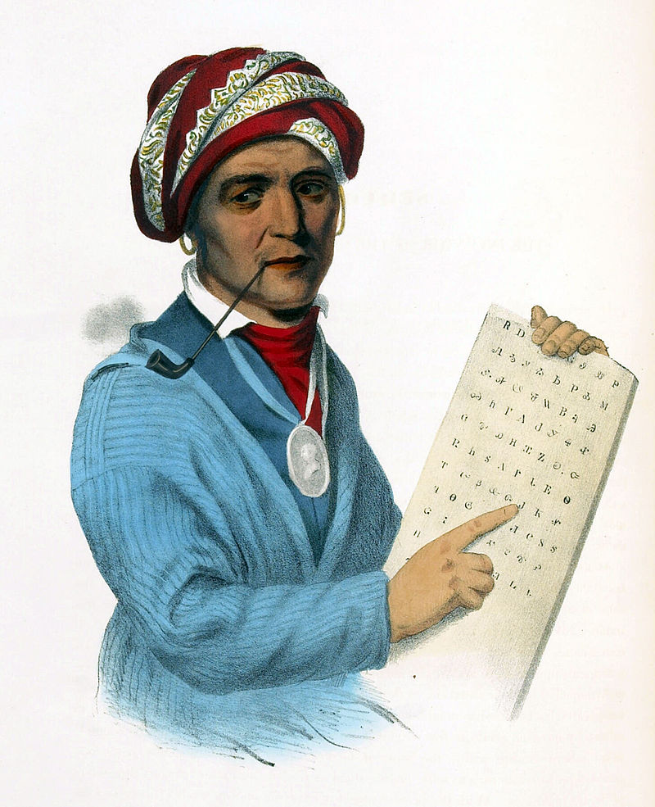
Cherokee
Role of Men/Women in Society
Men – Made political decisions
Women – Made social decisions, owned land
Role in US History
Trail of Tears: Forced relocation of thousands of Cherokees by the U.S. Government. Upon arrival Sequoyah developed an alphabet to improve relationship with the settlers.
Trail of Tears

Slide 17
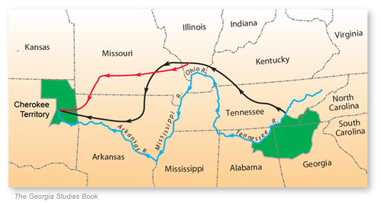
Trail of Tears

